Slide 1

Amazon Capstone Project
Amazon Capstone Project
Here is our presentation begins
Here is our presentation begins

Slide 2
Project Overview
The project aims to conduct a comprehensive analysis of sales data from Amazon, one of the world's largest online retailers. By leveraging advanced analytics techniques, the goal is to extract actionable insights that can inform strategic decisions, improve operational efficiency, and enhance overall business performance presentation, highlighting the key findings and insights from the analysis, tailored to different stakeholders' needs.
Examine customer purchasing behavior, including preferences, buying frequency, and customer segmentation

Slide 3
Project Scope
analysis on the data to understand the different product lines and the sales trends of product, the products lines performing best and profitability of each customer segment

Slide 4
Business Problem
“this project is to gain insight into the sales data of Amazon to understand the different factors that affect sales of the different branches..”

Slide 5

Business Objective And Constraints
Objectives:
Understand Sales Trends
Customer Behavior Analysis
Product Performance Assessment
Constraints:
Compare Amazon's sales performance with competitors, identifying strengths, weaknesses, and areas for improvement.

Slide 6
Approch of the project
Data Wrangling
Feature Engineering
Exploratory Data Analysis

Slide 7
01 Data Wrangling
Build a database
Create a table and insert the data.
Checking Null Values and replacing with appropriate Methods

Slide 8
02 Feature Engineering
Adding a new column named timeofday to give insight of sales in the Morning, Afternoon and Evening
Adding a new column named dayname that contains the extracted days of the week on which the given transaction took place (Mon, Tue, Wed, Thur, Fri).
Adding a new column named monthname that contains the extracted months of the year on which the given transaction took place (Jan, Feb, Mar).
By Applying Feature Engineering Techniques This will help answer the question on which part of we are finding Usefull insights

Slide 9
03 Exploratory Data Analysis
Data Collection
Data Cleaning and Preprocessing.
exploratory analysis to visualize sales trends

Slide 10
Project stages
01
02
03
Product Analysis
Sales
Analysis
Customer
Analysis

Slide 11
Product Analysis
01
Conducting analysis on the data to understand the different product lines

Slide 12
Understanding Different Product Lines:
01
02
03
Health and beauty
Electronic accessories
Home and lifestyle
04
05
06
Sports and travel
Food and beverages
Fashion accessories
There 152 products in health and beauty
There 170 products in Electronic accessories
There 160 products in Home and lifestyle
There 166 products in Sports and travel
There 174 products in Food and beverages
There 178 products in Fashion accessories

Slide 13

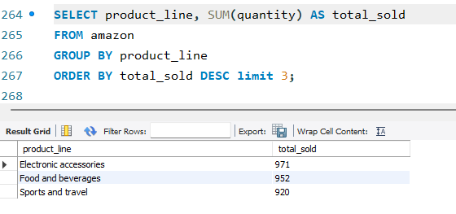
By analyzing the total quantity sold for each product line, you can identify the top-performing product lines. This insight can guide resource allocation, such as increasing inventory for popular product lines. 1 Electronic accessories are sold quantity of 971 products 2 Food and beverages sold quantity of 952 products 3 sports and travel sold quantity of 920 products
Product Lines Performing Best:

Slide 14
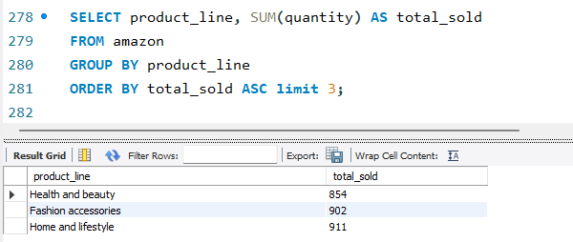
Product Lines Needs Improvement (Based on Quantity Sold)
Identifying product lines with lower total sales can highlight areas for improvement, such as adjusting pricing, marketing efforts, or product features to increase demand.
1 Health and beauty product has low quantity sold 854
2 Fashion accessories product has minimum quantity sold 902
3 Home and lifestyle product has sold 911 quantity of products
This products are need to be improve because based quantity sales are less compared to other products

Slide 15
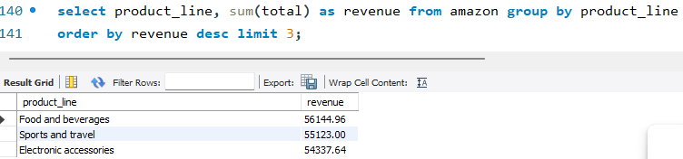
Product Lines Generated The Highest Revenue
Query:
Insights:
Food and beverages , Sports and travel and Electronic accessories are generate 56144,55123,54337 Revenue Respectively
Health and beauty, Home and lifestyle, Fashion accessories are generate 49193,5386,54306 lowest Revenue Respectively
Aggregating revenue by product line grouping by the product line column and summing the total column helps identify which product categories contribute the most to overall revenue. This insight informs inventory management, marketing strategies, and product development efforts.

Slide 16
Which product line is most frequently associated with each gender
Product Lines | Male | Female
Fashion Accessories | 82 | 96
Food and beverages | 84 | 90
Sports and travel | 78 | 88
Electronic accessories | 86 | 84
Home and lifestyle | 81 | 79
Health and Beauty | 88 | 64

Slide 17
Sales Analysis
02
Conducting analysis on effectiveness of each sales strategy

Slide 18

Which product line has the highest sales?: Query: select product_line , sum(total) as total_sales from amazon group by product_line order by total_sales desc;
Product Lines
Total Sales
Food and beverages 56144.96
Sports and travel 55123.00
Electronic accessories 54337.64
Fashion accessories 54306.03
Home and lifestyle 53861.96
Health and beauty 49193.84
Insights:
Food and Beverages have highest sales 56144.96
Sports and Travel have second highest Sales 55123.00
Electronic Accessories have third highest Sales 54306

Slide 19
which month did the cost of goods sold reach its peak?: Query: select sum(cogs) as cost_of_goods_sold, monthname from amazongroup by monthname order by cost_of_goods_sold desc;
Cost of goods sold
Month name
110754.16 | January
104243.34 | March
92589.88 | February
Insights:
In the January month cogs is 110754.16
In the March month cogs id 104243.34
In the February month is cogs is 92589.88

Slide 20
product line, add a column indicating "Good" if its sales are above average, otherwise "Bad.“: Query: SELECT product_line, SUM(total) AS total_sales, AVG(total) AS average_sales, CASE WHEN SUM(total) > AVG(total) THEN 'Good’ ELSE 'Bad’ END AS sales_performance FROM sales GROUP BY product_line ORDER BY total_sales DESC;
Product Lines total Sales Average Sales Sales Performance
Food and beverages 56144.96 322.672184 Good
Sports and travel 55123.00 332.066265 Good
Electronic accessories 54337.64 319.633176 Good
Fashion accessories 54306.03 305.090056 Good
Home and lifestyle 53861.96 336.637250 Good
Health and beauty 49193.84 323.643684 Good
Insights:
Food and beverages sales is 56144.96 avg sales is 322.672184 it is Good
Sports and travel sales is 55123.00 avg sales is 332.066265 it Good
Electronic accessories sales is 54337.64 sales is 319.633176 it is Good

Slide 21
Identify the branch that exceeded the average number of products sold: Query: select branch, COUNT(product_line) AS num_products_sold from amazon group by branch;
Branch
Num Product Sold
A | 340
C | 328
B | 332
Insights:
Branch A has 340 product sold
Branch C has 328 product sold
Branch B has 332 product sold

Slide 22
Customer Analysis
03
Conducting analysis to uncover the different customer segments, purchase trends and the profitability of each customer segment.

Slide 23

What is the count of distinct customer types in the dataset: 1 Member 2 Normal Which customer type occurs most frequently?: Normal customers type occurs Identify the customer type with the highest purchase frequency: Query: select customer_type , sum(total) as total from amazon group by customer_type order by total desc; Customer Type Total Insights: Member Customer Type Made Highest Purchase 164223.81 Normal Customer Type Made Second Highest Purchase 158743
Member | 164223.81
Normal | 158743.62

Slide 24
Determine the predominant gender among customers:
Query:
select gender , count(*) as gender_count from amazon group by gender order by gender_count desc ;
Gender gender Count
Female | 501
Male | 499
Examine the distribution of genders within each branch:
select gender , branch , count(*) as gender_count from amazon group by branch,gender order by branch, gender_count desc;
Branch | Gender | Gender Count
A | Male | 179
A | Female | 161
B | Male | 170
B | Female | 162
C | Female | 178
C | Male | 150

Slide 25
Identify the time of day when customers provide the most ratings:
Query: select timeofday ,max(rating) as most_ratings from amazon group by timeofday;
Time of Day | Most Ratings
Afternoon | 10.0000
Morning | 10.0000
Evening | 10.0000
Determine the time of day with the highest customer ratings for each branch:
Query:
select branch,timeofday , max(rating) as highest_ratings from amazon group by branch,timeofday;
Branch | Time of Day | Highest Ratings
A | Afternoon | 10.0000
C | Morning | 9.9000
A | Evening | 9.8000
A | Morning | 9.9000
C | Evening | 9.9000

Slide 26
Thanks!

